Slide 1







PRESENTATION ON,
PROCESS SCHEDULER SIMULATOR.
Presented To -
Presented By -
Saima Siddique Tashfia
Lecturer, Dept. of CSE
UITS.
Md. Mehadi Hasan, ID : 2125051003
Maheru Tabassum Ohana, ID : 2125051015
Sowrobh Bhuiyan, ID : 2125051026
Mofidul Haque Nibir, ID : 2125051020

Slide 2


BORCELLE
Introduction
The Process Scheduler Simulator, built using Cygwin, simulates five key CPU scheduling algorithms: FCFS, Non-Preemptive SJF, Preemptive SJF, Round Robin, and Priority Scheduling. It is an interactive, menu-driven educational tool for mastering CPU scheduling concepts.
Page 01

Slide 3


BackGround
Inspired by OS Lab coursework.
Combines multiple scheduling techniques into one tool.
Simplifies algorithm learning & comparison.
Added Priority Scheduling for broader scope.
Page 02

Slide 4
Methodology
Environment: Used Cygwin for Linux scripting on Windows.
Testing: Tested diverse cases and handled invalid/zero inputs.
01
02
Design & Implementation: Menu-driven script with clear options for each algorithm. Functions handle inputs, compute outcomes, and display results.
Documentation: Hosted on GitHub: https://github.com/Ahana-tabassum/OS_Project
03
04
Page 03

Slide 5
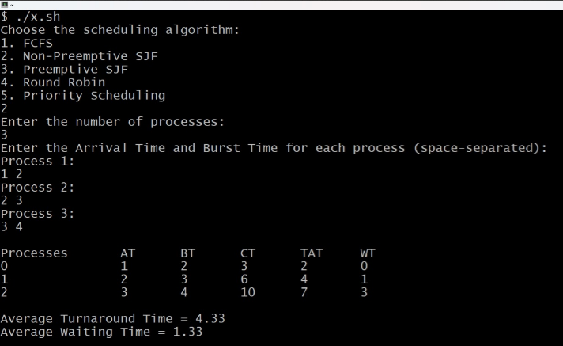
BORCELLE
Output
Correct scheduling outcomes with user inputs.
Educational tool for understanding CPU scheduling.
Page 04

Slide 6

Limitations
Cygwin Issues: Compatibility, setup, performance.
Limited error handling.
Slower than native Linux systems.
Page 05

Slide 7
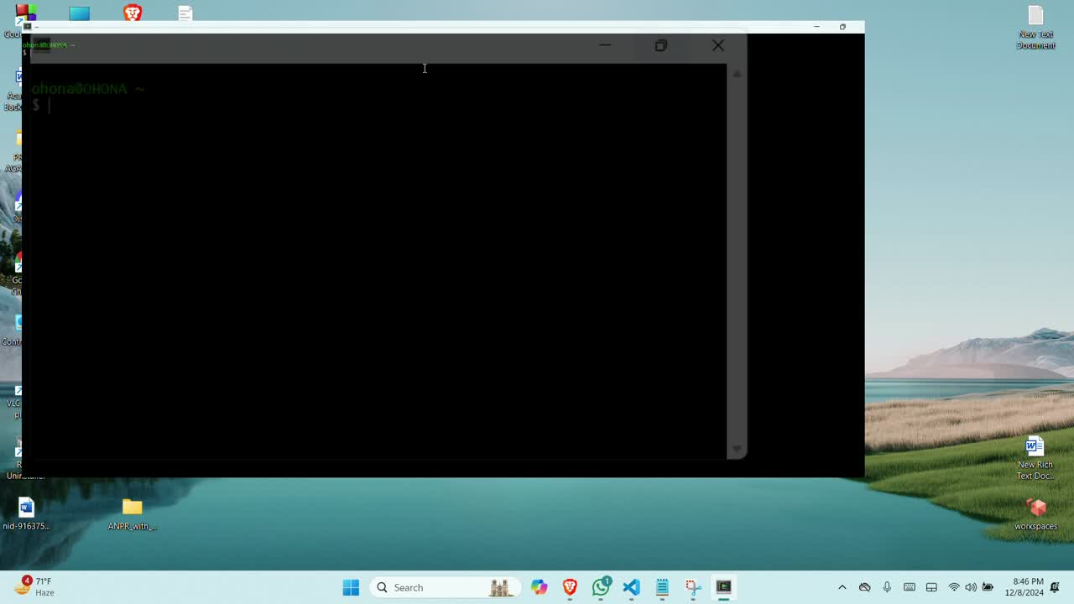
Page 06

Slide 8
BORCELLE
Future Work
Add GUI for better user experience.
Real-time process simulation.
Include advanced algorithms (e.g., Multilevel Feedback Queue).
Integrate performance metrics (turnaround, waiting time).
Page 07

Slide 9
BORCELLE
Conclusion
The project successfully simulated five scheduling algorithms, providing insights into CPU scheduling techniques, including Belady's Anomaly in certain algorithms like FIFO. Through this process, we gained proficiency in shell scripting and deepened our understanding of algorithmic logic. The tool serves as an effective educational resource, helping users explore fundamental OS concepts and the nuances of scheduling, such as the impact of page replacement policies.
Page 08

Slide 10
References
Silberschatz et al., Operating System Concepts, 9th Ed.
Tanenbaum, Modern Operating Systems, 4th Ed.
Stallings, Operating Systems: Design Principles, 9th Ed.
Jacob & Johnson, CPU Scheduling Algorithms Survey (2017).
Page 09

Slide 11
BORCELLE
THANKS
FOR YOUR ATTENTION

